Slide 1
SAFETY FIRST:
Classifying Fatality in Traffic Accidents
Kelly Jones | May 2018
Notes:
Everybody knows that you should wear your seatbelt. Everybody knows not to drive drunk. Everybody knows to be vigilant when driving near motorcycles or pedestrians. And yet, each year, we lose over 30,000 fellow Americans to traffic accidents, many of which are preventable. My name is Kelly Jones and I am here today to talk with you about the heavy but important topic of traffic fatalities. This presentation may not be especially surprising in its conclusions, but I hope that the truth of it really lands with each of us about the importance of following through on what everybody knows.

Slide 2
“Washington State has adopted Target Zero — a goal to reduce traffic fatalities and serious injuries on Washington's roadways to zero by the year 2030.
“Our goal is zero deaths and serious injuries, because every life counts.”
Notes:
This issue has enormous policy relevance. In Washington State, for instance, there is a public safety goal of reaching zero roadway deaths by the year 2030. For this project, I used classification models, machine learning, and data visualization understand whether each individual person involved in a fatal traffic accident was likely to survive or not.

Slide 3
Data
Person
Vehicle
Accident
Notes:
My dataset is national data from every motor vehicle accident with a fatality 2015. It is rich and detailed because of the investigation that surrounds a fatal accident. For my analysis, I pulled from three files with three levels of detail.

Slide 4
Model: Decision Trees
Boosted with “CatBoost”
1
INPUTS:
67 features
48K observations
OUTPUTS:
Feature Importance
Most Harmful Event
Person’s Age
Vehicle Damage
Restraint Use
TRAIN:
38K
TEST:
10K
Notes:
There are three parts to my project. The first was the model. I decided to use decision trees because my data was mostly categorical – even though it started out as numerical codes, which required substantial decoding. I had 48,000 complete observations which I split into a train and test set. One output of this model was determining feature importance. Some of the features that emerged were a result of how the data were structured, but some of the others were more relevant.

Slide 5
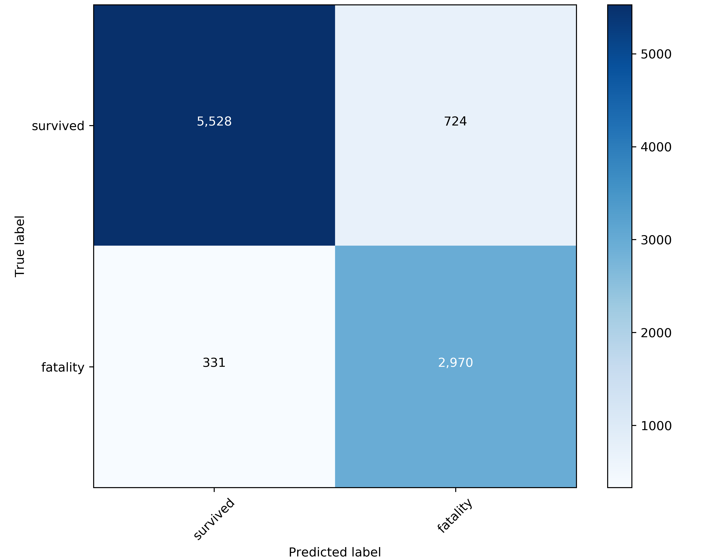
89%
80%
90%
Confusion Matrix
Accuracy How often we were right
5,528
724
Precision Avoiding false positives
331
2,970
Recall Detecting true positives
Notes:
Here are a few more model outputs. This confusion matrix shows how the model did on the test set. You can see that it correctly classified 5500 who survived and 3,000 fatalities (our positive condition). That’s an 89% accuracy. The precision was lower at 80% because we had a number of false positives, but the recall rate is probably most important – don’t want to miss warning signs of fatalities. Want to minimize 331 box (predicted survived but actually died). Those are cases our model can’t explain – for example, they were young, healthy, driving in a safe new car, their airbag went off, they were wearing a seatbelt, nobody was drunk, the weather was good… and yet, they still died. We want to understand what happened in those cases so we can help prevent them. (Corollary: not worried about false positives. How much does it harm a person to wear a seatbelt or to refrain from driving drunk?)

Slide 6
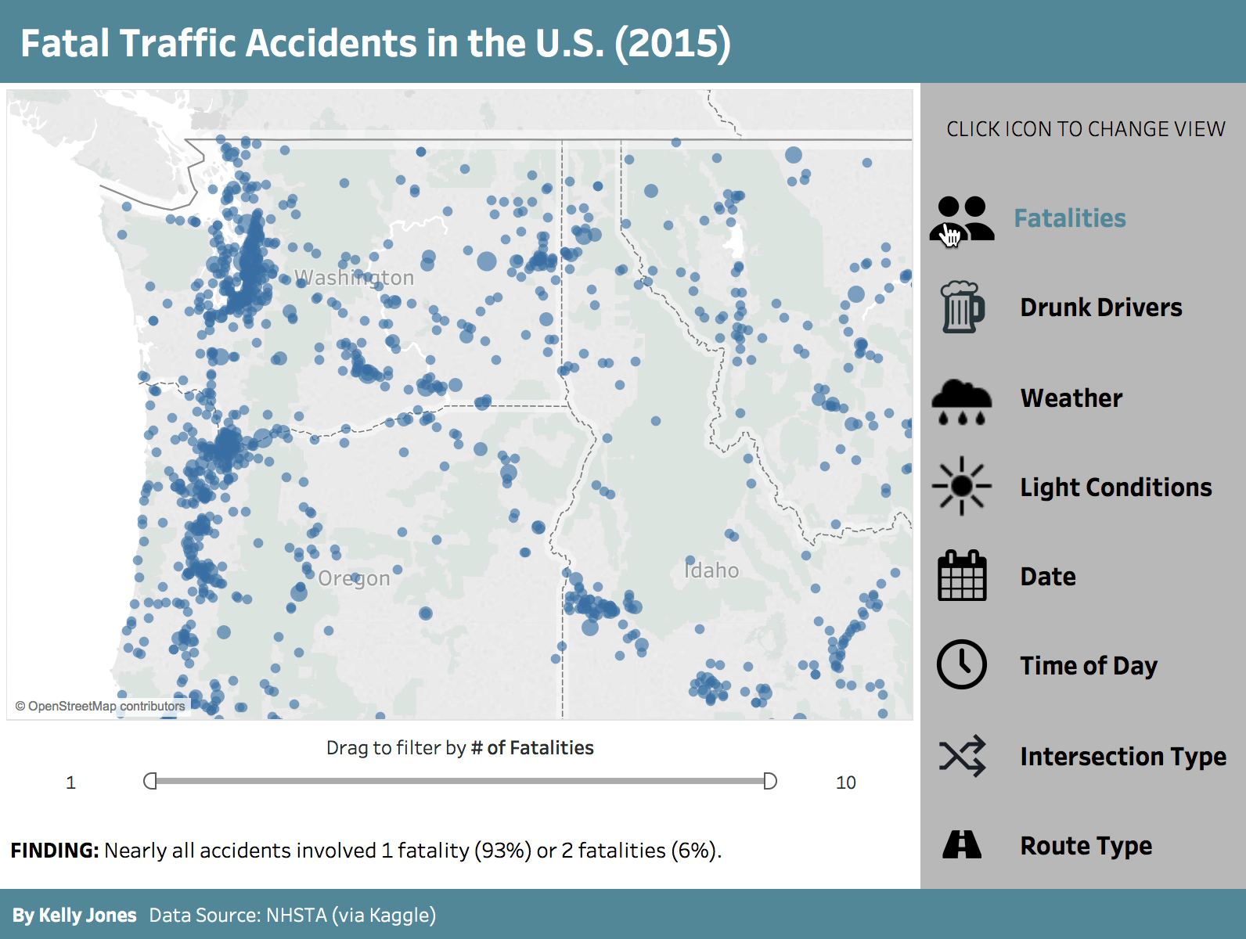
2.
Tableau Dashboards
Explore accident data nationwide
Notes:
3:00. Part 2 was a Tableau dashboard to help visualize the data.

Slide 7
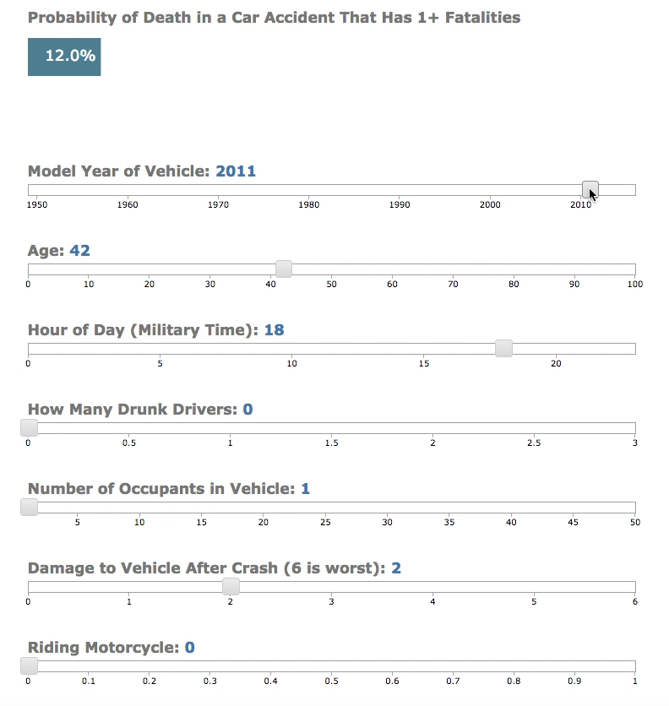
3.
Flask App
Move sliders to get probability estimate of fatality
Model: Logistic Regression
Notes:
4:00 The dataset feeds a flask app which is based on a logistic regression model and shows how the probability of death changes as you move the sliders. You can see that probability increase with older cars, as the person’s age increases, by how many drunk drivers there were, the level of damage to the vehicle, being on a motorcycle, and so on.

Slide 8

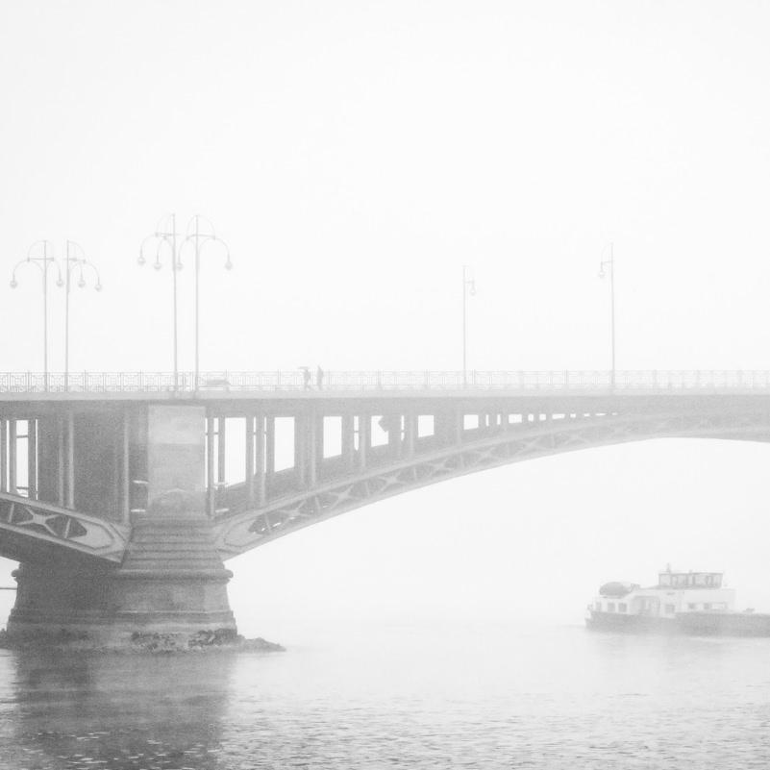

Next Steps
Event Sequence (Accident) ◆ Further Feature Importance ◆ Normalized Analysis by State
Notes:
4:30

Slide 9

THANK YOU!
Data Source | Target Zero (WA) | Project Files | Tableau Dashboards
Notes:
4:50 My hope is that by better understanding traffic fatalities, we will be able to prevent many, many more of them. Thank you.

